Slide 1
DEA
Data Envelopment Analysis

Slide 2

Forget the Traditional Use of LP (just for this exercise)

Slide 3
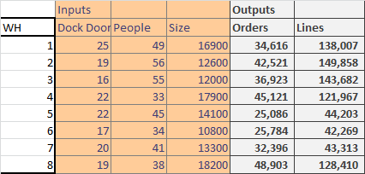
Which Warehouses are Doing Good?

Slide 4
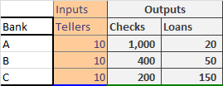
Which Are Good, Which Ones Not So Good?

Slide 5
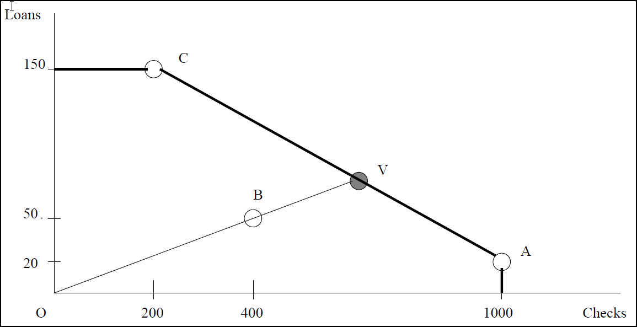
If we assume that we can create a “Virtual Bank” based on all the linear combinations of A and C, we can see that V is better than B

Slide 6
With some algebra, we can see that the Virtual Bank is about 54% of Bank A and 46% of Bank C. And, B is about 63% up the line segment OV, and that is its efficiency

Slide 7
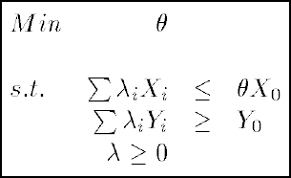
This Formulates into a Linear Program– This Analysis is Called Data Envelopment Analysis
DMU is our Decision Making Unit (or bank branch in this case)
Let X_{i} be the vector of inputs for DMU i.
Let Y_{i} be the vector of outputs for DMU i.
We run the LP once for every DMU
We call the DMU we are considering DMU 0
Let ϴ be the efficiency of the DMU we are considering
Let λ_{i} be the weight given to DMU i in its attempt to dominate the DMU we are considering

Slide 8
Notes about the Linear Program
If DMU is on the efficient frontier, ϴ can be set to 1 (100%) by having all the λ_{i}’s set to 0 except for the one we are considering and set to 100% for that one

Slide 9
What does the LP mean?
ϴ is the efficiency
Those DMU’s with a non-zero λ_{i} are the comparables
The goal inputs are the difference between X₀ and Σλ_{i}X_{i}
That is, what should this branch have as the inputs
The goal outputs are the 1/ ϴ Σλ_{i}Y_{i}
What should the outputs be if the inputs were fixed

Slide 10
I don’t find the interpretation of the LP very intuitive
The dual of this LP creates “prices” for all the inputs and “values” for all the outputs
The dual LP, when it solves for a particular DMU, tries to find the best combination of prices and value to put that DMU in the best possible light
Note the prices and values will be different for every run
Since the dual and primal give the same information, the optimization tries to show every DMU in its best possible light
The primal does this more geometrically (and is harder to explain)

Slide 11
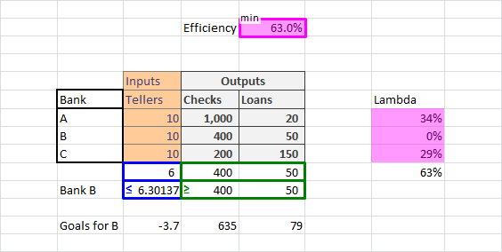
Results for the Bank Branches
The input goals show we should get the same output (400,50) with 3.7 fewer tellers
The output shows how much we should get with our inputs fixed

Slide 12
Let’s Revisit Our Earlier Case…

Slide 13
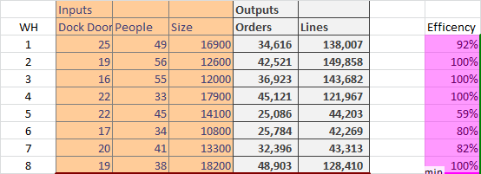

Full Scale Output Report
The output will give you the following
List of all the branches that are on the efficient frontier (100%)
List of those branches not on the efficient frontier, how far they are off, and the best branches to benchmark against.
For each inefficient branch, you can get information on how to do better

Slide 14
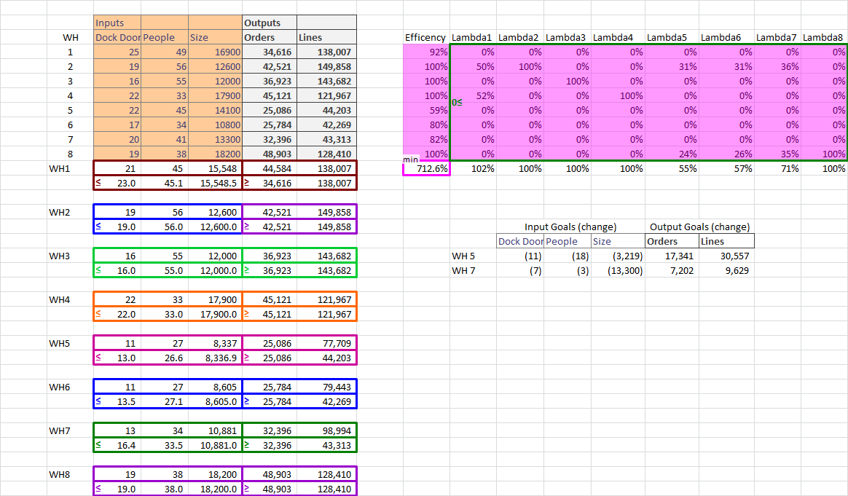
DEA Requires You to Solve One LP per DMU. However, the LP’s can be solved with one run. How?

Slide 15
Where Can This Be Applied
Where you have multiple DMU’s with different inputs and outputs
And, where the inputs and outputs are hard to compare
Bank branches
Retail stores
Service depots
Hospitals, Health care facilities
Schools
Manufacturing and Operations firms
With many similar operations

Slide 16

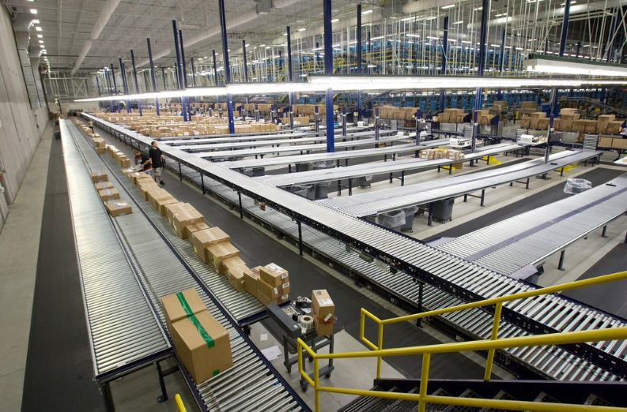

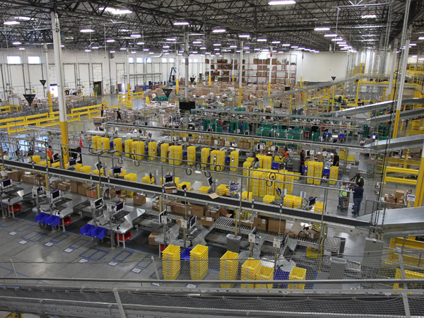

E-commerce Application

Slide 17
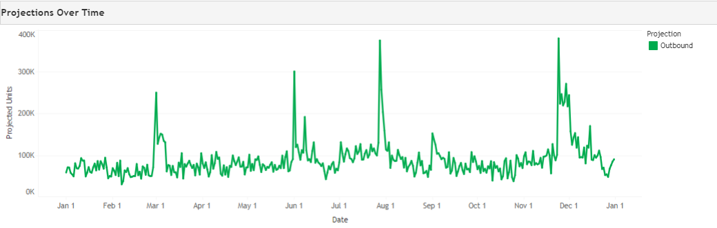
E-commerce Application- Need to plan for spikes
Need to plan for these spikes– it is hard to know the productivity of people because there when there is nothing to work on (a lot of the year), they aren’t producing. DEA was used to help determine the actual productivity
A fun side fact: the answer used multi-objective optimization, trading off cost vs how many orders missed the delivery

Slide 18
What To Watch Out For with DEA
Up to now, we’ve assumed Constant Returns to Scale (CRS)
This means that the variables relate to each other linearly
We can create virtual DMUs with a “straight line” between existing DMUs
One Method for Modeling Variable Returns to Scale is add a constraint ensuring that the λ_{i}’s sum to 1
This will tend to raise the efficiency scores
Strengths
Compare multiple input and outputs (and these can have different units of measure)
Doesn’t require a mathematical function to tie input to outputs
DMU’s are compared against peers
Weaknesses
Need to watch out for CRS and VRS
Noise in data can cause problems

